Slide 1
Proverbs and The Fool
Wisdom for all to live God’s way in His world.
pe·ṯî - simple – root of “to be fooled” – a gullible person
14v15 “The simple believe anything, but the prudent give thought to their steps”
The question is direction!
The free offer of Wisdom 1v20-33 which requires discipline
Or down a slippery slope
Downward progression seen in the words used in the fools gallery

Slide 2
Proverbs and The Fool
The journey into foolishness from being simple
Words:-
ḵə·sîl – dull and obstinate
’ĕ·wîl – stupidity and stubbornness
nā·ḇāl – as above with added boorishness
lêṣ - the scorner
Proverbs see the problem for each as being a man’s chosen outlook, rather than his mental equipment
Attitude not aptitude
Problem is spiritual not intellectual

Slide 3
How to become a fool – step 1
Lack of self awareness – 26v12 “Do you see a person wise in their own eyes? There is more hope for a fool than for them.”
See no need of wisdom as they think they have arrived!
Doesn’t heed correction - 17v10 “A rebuke impresses a discerning person more than a hundred lashes a fool.”

Slide 4
How to become a fool step 2
Drift 1v32 “For the waywardness of the simple will kill them, and the complacency of fools will destroy them”
7v7-9 “I saw among the simple, I noticed among the young men a youth who lacked judgment. He was going down the street near her corner, walking along in the direction of her house at twilight, as the day was fading, as the dark of night set in”

Slide 5
How to become a fool step 3
Enjoy the life of folly and the ease of it
15v21 “Folly delights a man who lacks judgement”
17v24 “A discerning person keeps wisdom in view, but a fool’s eyes wander to the ends of the earth.”
12v11b “those who chase fantasies have no sense.” and 14v23b “mere talk leads only to poverty”
17v16 “Why is there in the hand of a fool the purchase price of wisdom, Since he has no heart for it?”

Slide 6
How to become a fool steps 4 and 5
Company 13v20 “Walk with the wise and become wise, for a companion of fools suffers harm.”
1v10 “My son, if sinners entice you, do not give into them”
1v13-14 “we will get all sorts of valuable things and fill our houses with plunder; throw in your lot with us, and we will share a common purse”
1 Cor 15v33 “Do not be misled: ‘Bad company corrupts good character.’ ”
Repeat the same mistakes 26v11 “As a dog returns to its vomit, so fools repeat their folly.

Slide 7
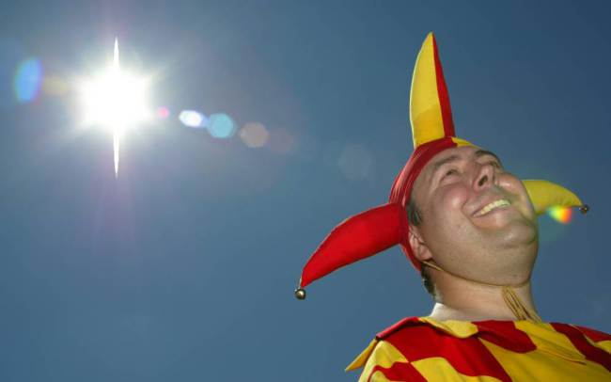
How to spot a fool

Slide 8
Look for foolishness near to home

Slide 9
How to spot a fool 1
Getting and using money “Dishonest money dwindles away, but whoever gathers money little by little makes it grow.”
Their talk 14v7 “Stay away from a fool, for you will not find knowledge on their lips”.
Their temper
Fierce 17v12 “Better to meet a bear robbed of her cubs than a fool bent on folly.”
Uncontrolled 29v11 “A fool always loses his temper, But a wise man holds it back” NASB
Argumentative 20v3 “It is to one’s honour to avoid strife, but every fool is quick to quarrel.”

Slide 10
How to spot a fool 2
Unreasonable 1 Sam 25v17 of Nabal “Now think it over and see what you can do, because disaster is hanging over our master and his whole household. He is such a wicked man that no one can talk to him.”
Lacking proportion
Mean spirited
Troublemaker 29v8 “Mockers stir up a city, but the wise turn away anger.”
Attitude to correction 9v7 “Whoever corrects a mocker invites insults; whoever rebukes the wicked incurs abuse.”
Attitude to sin 14v9 “Fools mock at making amends for sin”

Slide 11
Proverbs and adultery
What happened to that simple youth we meet in Proverbs chapter 7?
Adultery as in Proverbs 7v21 “With persuasive words she led him astray; she seduced him with her smooth talk.”
Sexual sins – in mind or deed Proverbs chapter 5
Spiritual adultery – false religions, cults, materialism, self, nominal Christianity
What is your slippery slope? What sins are you willing to toy with?

Slide 12
The End of the foolish
7v22-27 “All at once he followed her like an ox going to the slaughter, like a deer stepping into a noose ²³ till an arrow pierces his liver, like a bird darting into a snare, little knowing it will cost him his life.
²⁴ Now then, my sons, listen to me; pay attention to what I say. ²⁵ Do not let your heart turn to her ways or stray into her paths. ²⁶ Many are the victims she has brought down; her slain are a mighty throng. ²⁷ Her house is a highway to the grave, leading down to the chambers of death.”

Slide 13
Summary of foolishness
Do not have a light attitude to sin 14v9 “fools mock at making amends for sin”
Instead choose the fear of the Lord
1 Kings 18v21 “Elijah went before the people and said, ‘How long will you waver between two opinions? If the Lord is God, follow Him; but if Baal is God, follow him”.’
Guard yourself with good company, bad company corrupts good character

